Slide 1



AI–Powered Garbage Classification System

Slide 2

Learning Objectives
♻️ Automate garbage classification into categories: cardboard,
glass, metal, paper, plastic, and trash
Automate garbage classification into categories: cardboard,
🤖 Develop a custom image classification model using CNN
& pretrained architectures like EfficientNet.
🌱Use metrics like accuracy, precision, recall, and confusion
matrix to assess model effectiveness.
🙌 Learn how image classification works using deep learning
models and computer vision techniques.
🗑️ Apply techniques such as data augmentation, transfer
learning, and hyperparameter tuning
glass, metal, paper, plastic, and trash
GOAL
Source :
www.freepik.com/

Slide 3








Tools and Technology used
For data visualization and evaluation used Matplotlib and Seaborn
Core programming language used is python
Scikit-Learn
For model evaluation metrics
Image preprocessing
and handling using open CV
Data Manipulation and Processing using NumPY and Pandas
Gradio used for
Interactive Web-Based Interface
For deep learning
model development used tenserflow
EfficientNet
Used for transfer learning

Slide 4
Methodology
DATA COLLECTION :-We began by using a labeled dataset of waste images and analyzed the class distribution, visualized sample images, and examined basic properties of the data.
DATA PROCESSING:-Images are resized to a standardized input shape, normalized for pixel values, and enhanced using data augmentation techniques such as rotation, flipping, and zooming to improve model generalization.
MODEL SELECTION AND TRAINING:-We used a pretrained EfficientNetV2B2 model for feature extraction and added custom CNN layers for classification.
EVALUATION :-The model’s performance was evaluated using accuracy, loss, confusion matrix, and classification report. Training history was also visualized to monitor overfitting and underfitting trends.
MODAL ENHANCEMENT & RETRAINING:-To improve accuracy, we fine-tuned EfficientNet layers and experimented with dropout layers, batch normalization, and learning rate adjustments.
DEPLOYMENT:- At last, the trained model was exported for deployment and integration into real-world applications

Slide 5
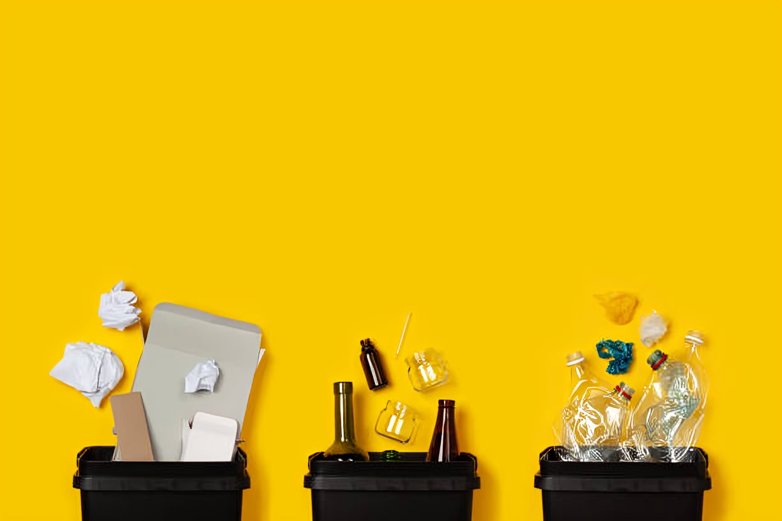
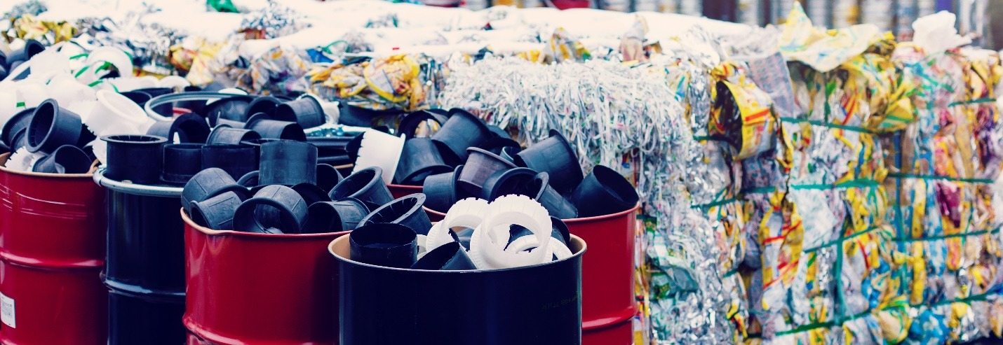
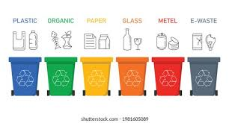
PROBLEM STATEMENT
Develop an image classification model that sorts waste images into their correct categories. The dataset contains labeled images of garbage in six classes (cardboard, glass, metal, paper, plastic, trash).
The goal is to take a photo of a waste item and correctly classify it
(e.g. identify whether it is plastic, paper, etc.).

Slide 6
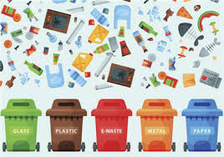
SOLUTION
To address the problem of manual waste sorting, we developed a deep learning-based image classification model using Transfer Learning with EfficientNetV2B2 and custom CNN layers.
The model is trained on a labeled dataset of waste images and is capable of accurately classifying them into six categories: cardboard, glass, metal, paper, plastic, and trash.
An interactive Gradio web interface is also integrated, allowing users to upload waste images and receive instant predictions in real time.

Slide 7
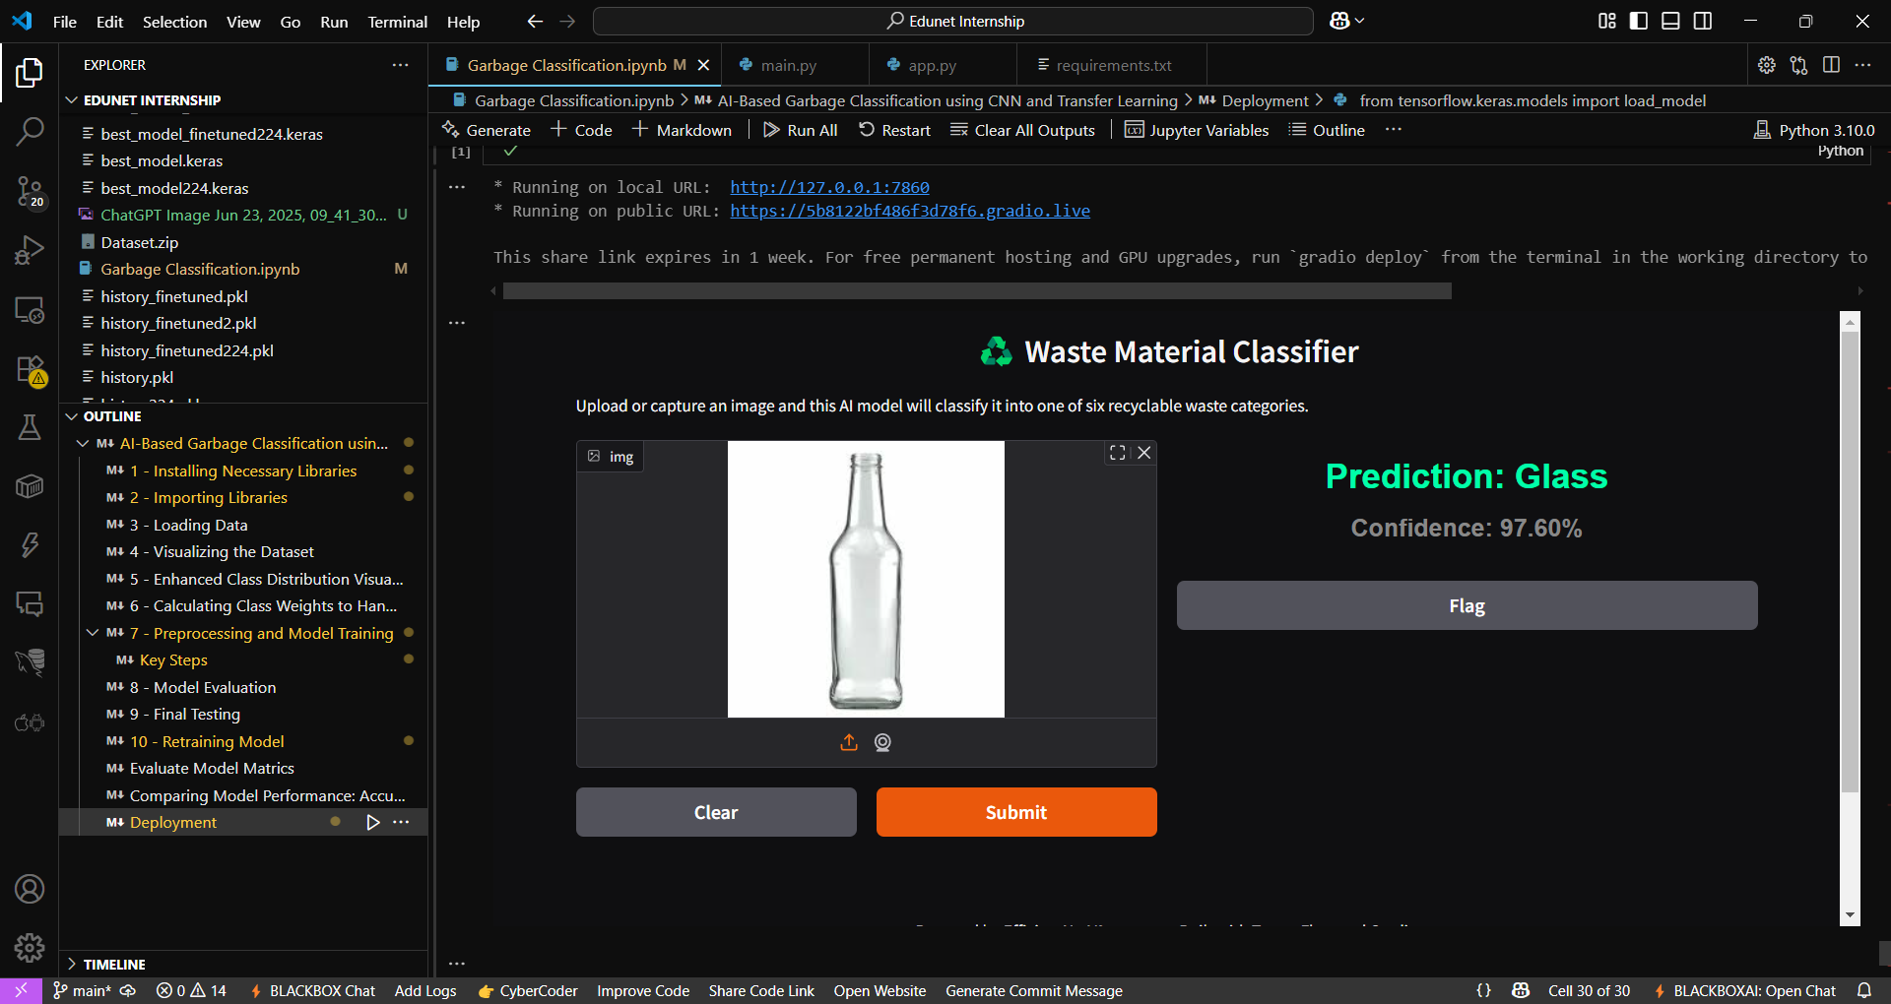
Screenshot of Output:

Slide 8
Conclusion:
The project successfully demonstrated the use of deep learning for automatic Garbage classification. By leveraging a pretrained EfficientNetV2B2 model along with custom CNN layers, we achieved accurate sorting of waste images into six categories.
The model was trained and fine-tuned using real-world data, with effective preprocessing and evaluation techniques and achieved 99% Training Accuracy and 95% Validation Accuracy.
This solution has the potential to support smart waste management systems, reduce manual effort, and promote environmental sustainability through AI-driven automation.
It can help create smart bins for future that identifies garbage on its own and classify waste

Slide 9
Github link:-
https://github.com/RASHMI-khetwal

Slide 10
THANK YOU
By-
Rashmi khetwal

